Slide 1

Digital Data (Part-2)
Understanding Data Representation and Compression

Slide 2
Learning Outcomes
By the end of this lesson, you will:
Understand the impact of using bits to store data.
Learn how different types of data (text, images, videos) are stored using bits.
Discover what data compression is and why it’s important.
Explore different data compression algorithms and how they work.
Learn to choose the best compression method for different files.

Slide 3
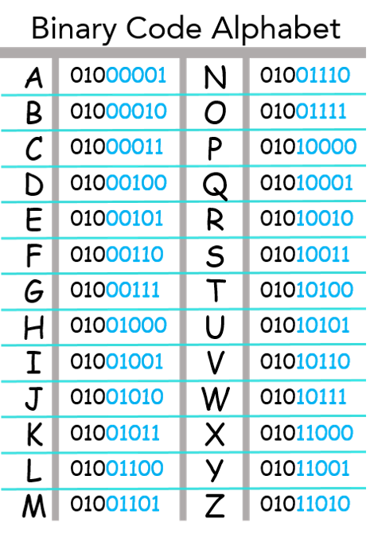
How Using Bits Affects Data Storage
What are Bits?
A bit is the smallest piece of data, either a 0 or a 1.
Groups of bits can represent any type of information, like letters, images, or videos.
Why does this matter?
Everything we see on a computer screen is represented in bits. The more detailed the file, the more bits are needed.
File Size and Storage:
Larger files require more storage space because they contain more bits.
Example: A high-quality photo could have millions of bits!

Slide 4
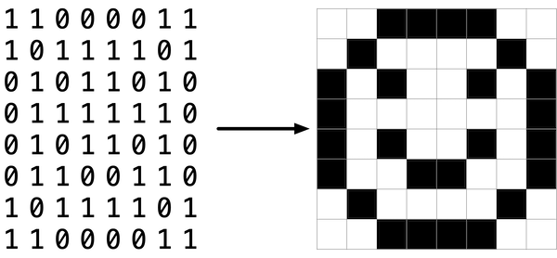
Different Types of Digital Data
Text:
Stored using a code like ASCII (where each character is represented by 8 bits).
Example: "A" is 01000001 in binary.
Images:
Each pixel in an image is stored as bits. More pixels = more bits.
Example: RGB images store each pixel using 24 bits (8 bits each for red, green, and blue).
Videos and Sound:
Videos are made up of many images (called frames), and sound is broken into samples. Both use lots of bits to store.

Slide 5
Why Big Files Are a Problem
Storage Space:
Computers, phones, and other devices have limited space. Big files take up more room, leaving less for other things.
Speed:
Large files take longer to upload, download, and send across the internet.
Processing Power:
Big files also take more power and memory for your computer to process and display, slowing things down.

Slide 6
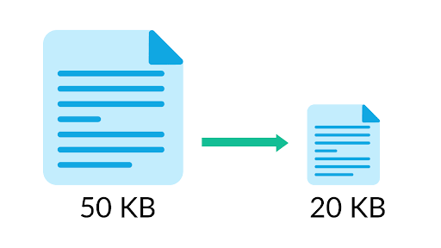
What is Data Compression ?
Data Compression: A way to reduce file size by using fewer bits to represent the same information.
Why is this important?
Saves space: Compressed files use less storage.
Faster: Compressed files upload, download, and transfer faster.
Types of Compression:
Lossless Compression: Reduces file size without losing any data.
Lossy Compression: Reduces file size by removing some less important data.

Slide 7
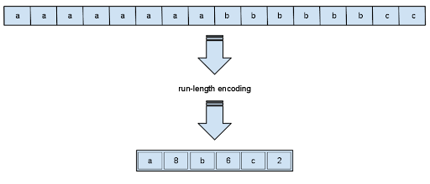
Lossless Compression Explained
Lossless Compression: Compresses data without losing any information. Great for text, documents, and PNG images.
Example:
The text "AAA BBB CCC" can be compressed to "A3 B3 C3" (3 As, 3 Bs, 3 Cs). When uncompressed, you get the exact same data back.
When to use lossless:
When it’s important to keep original quality. For example, for documents or high-quality images.

Slide 8

Lossy Compression Explained
Lossy Compression: Compresses data by removing parts that are less important and can’t be restored perfectly. Ideal for photos, videos, and audio.
Example:
A JPEG image removes fine details that most people won’t notice, reducing the file size significantly.
MP3 audio removes sounds we can’t hear, making the file smaller.
When to use lossy:
When small file size is more important than perfect quality, like streaming music or sharing photos online.

Slide 9
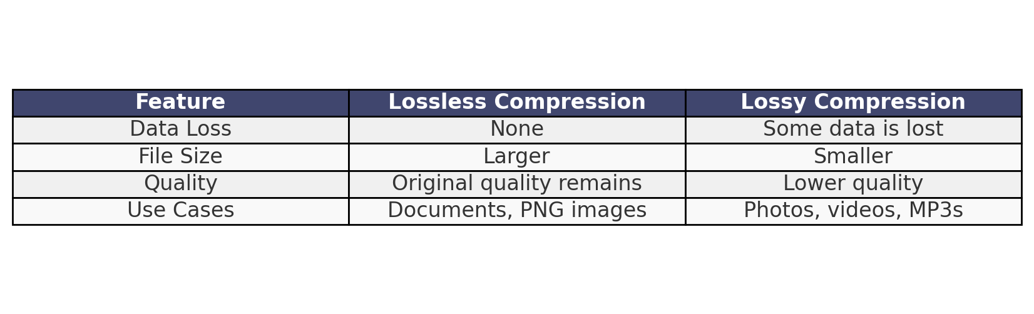
Lossless vs. Lossy Compression

Slide 10
How Computers Store Images
Bitmap Images:
Each pixel in an image is stored as bits.
Example: In a black-and-white image, each pixel could be stored as either 0 (black) or 1 (white).
Compressed Images:
Images like JPEG use fewer bits by removing less noticeable details.
A 10MB image could be reduced to 1MB using compression.

Slide 11
Types of Compression Algorithms
Run-Length Encoding (RLE):
Used in lossless compression to shorten repeated data.
Huffman Coding:
A method that assigns shorter codes to frequently used symbols, saving space.
JPEG Compression:
Used for images, reduces the amount of fine detail while still looking good.
MP3 Compression:
Used for audio, removes parts of the sound that we can’t hear.

Slide 12

Activity: Compress Your Own Files !
Take a large image file from your computer.
Compress it using a ZIP tool (lossless compression).
Compress it using a JPEG converter (lossy compression).
Compare the original and compressed files:
What happened to the file size?
Did you notice any change in quality?

Slide 13

Key Takeaways
Bits control how data is stored and represented.
Data compression helps save space and make file transfers faster.
Lossless vs. Lossy: Choose based on whether you need the original quality.
Compression is a balance between file size and quality.

